Slide 1

Queue In Data Structure
Submitted To:- Ms. Anika Garg (E12764)
Submitted By:- Ritesh Prasad Sah
UID:-23BCA10449
Sub:- Data Structure
Sec:- 7 “B”

Slide 2

Queue in C++
Queues are fundamental data structures in computer science, offering a First-In, First-Out (FIFO) approach to data management. This presentation will delve into the intricacies of queues within the C++ programming language.

Slide 3

Introduction to Queues
1
Data Structure
2
FIFO Principle
3
Real-World Analogy
A queue operates like a line where elements are added at the rear and removed from the front.
The first element added to the queue is the first one to be retrieved.
Queues are used in various real-world scenarios, such as waiting lines at a supermarket or a customer support call center.

Slide 4




Basic Operations: Enqueue and Dequeue
Enqueue
Dequeue
Peek
The operation of adding a new element to the rear of the queue.
The operation of removing and retrieving the element from the front of the queue.
This operation retrieves the element at the front of the queue without removing it.

Slide 5
Implementation of Queue Using Arrays
Static Allocation
Circular Queue
Advantages
Fixed-size array for queue storage. It's straightforward but lacks flexibility.
Overcoming the limitation of fixed-size arrays by wrapping around the array.
Array implementation is generally efficient due to direct memory access.

Slide 6
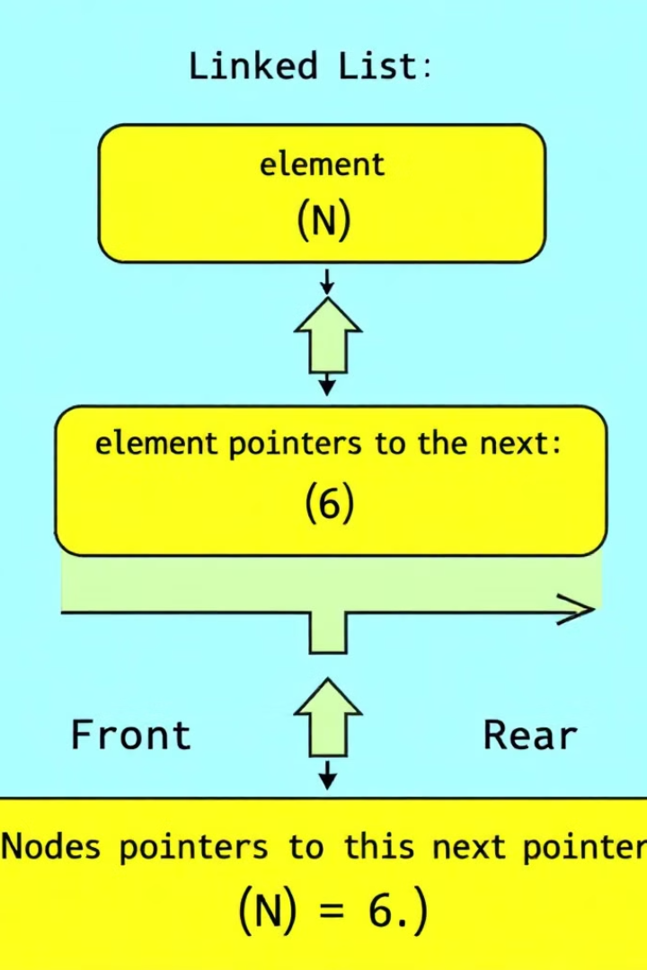
Implementation of Queue Using Linked Lists
Dynamic Allocation
The queue can grow or shrink as needed, providing flexibility.
Node Structure
Each node contains an element and a pointer to the next node.
Front and Rear Pointers
Pointers track the front and rear of the queue for efficient operations.

Slide 7
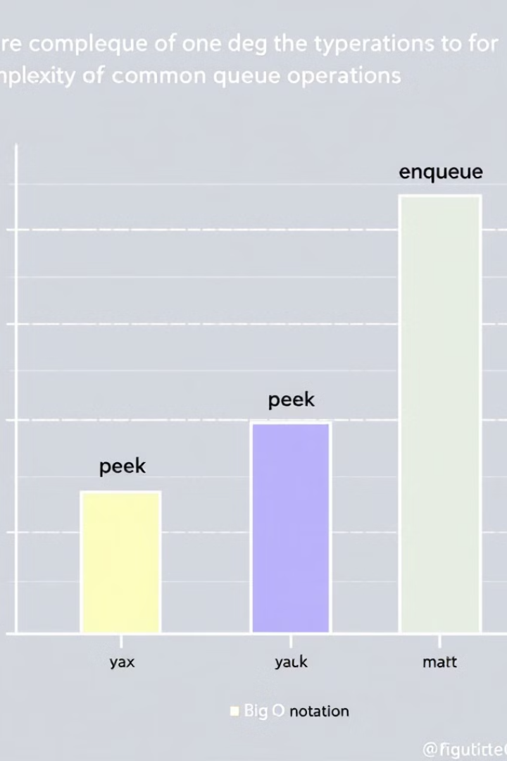



Time Complexity Analysis of Queue Operations
Enqueue
Time complexity is O(1) for both array and linked list implementations.
Dequeue
Time complexity is O(1) for both array and linked list implementations.
Peek
Time complexity is O(1) for both array and linked list implementations.

Slide 8
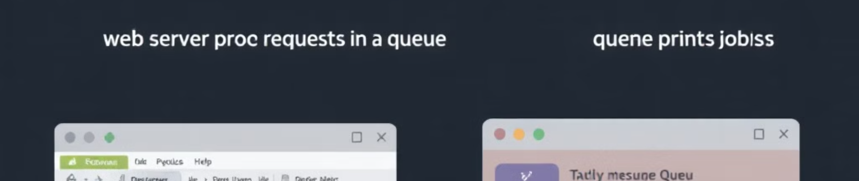
Applications of Queues
Web Servers
Operating Systems
Data Processing
Queueing requests from multiple clients ensures fair processing and efficient resource allocation.
Queues are used for managing tasks, printing jobs, and other system processes.
Queues streamline data processing, enabling the sequential handling of large datasets.

Slide 9
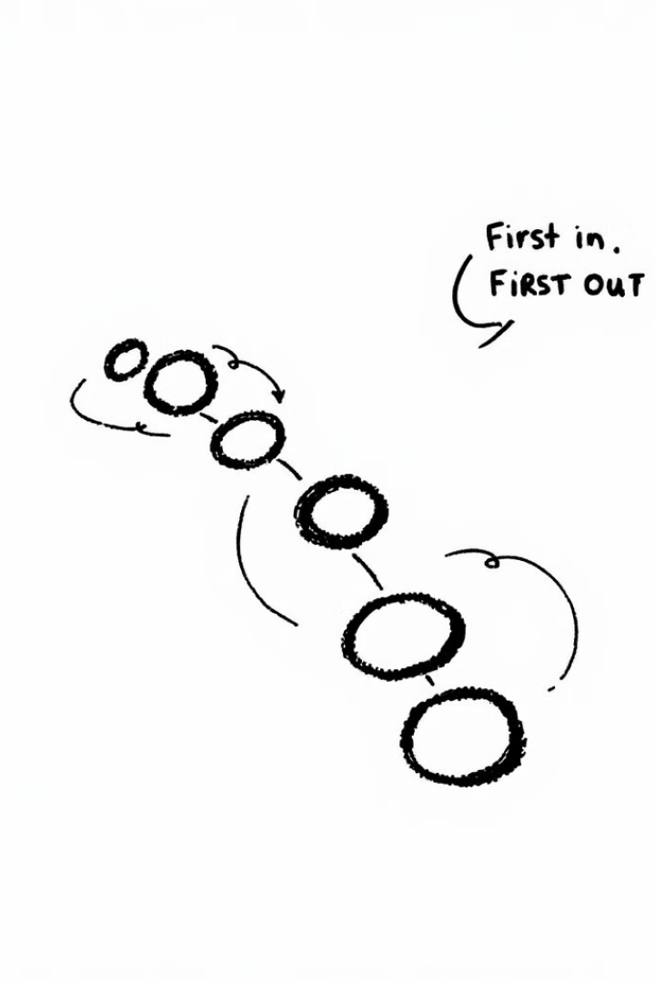
Conclusion and Key Takeaways
Queues provide a robust and efficient data structure for managing data in a First-In, First-Out manner. They're versatile and find applications in various domains of software development, from web servers to operating systems.

